Slide 1
Design Principles
Follow The Rules
Design First Code later

Slide 2
Follow The Rules
Color and Contrast
Typography
Hierarchy
Consistency

Slide 3
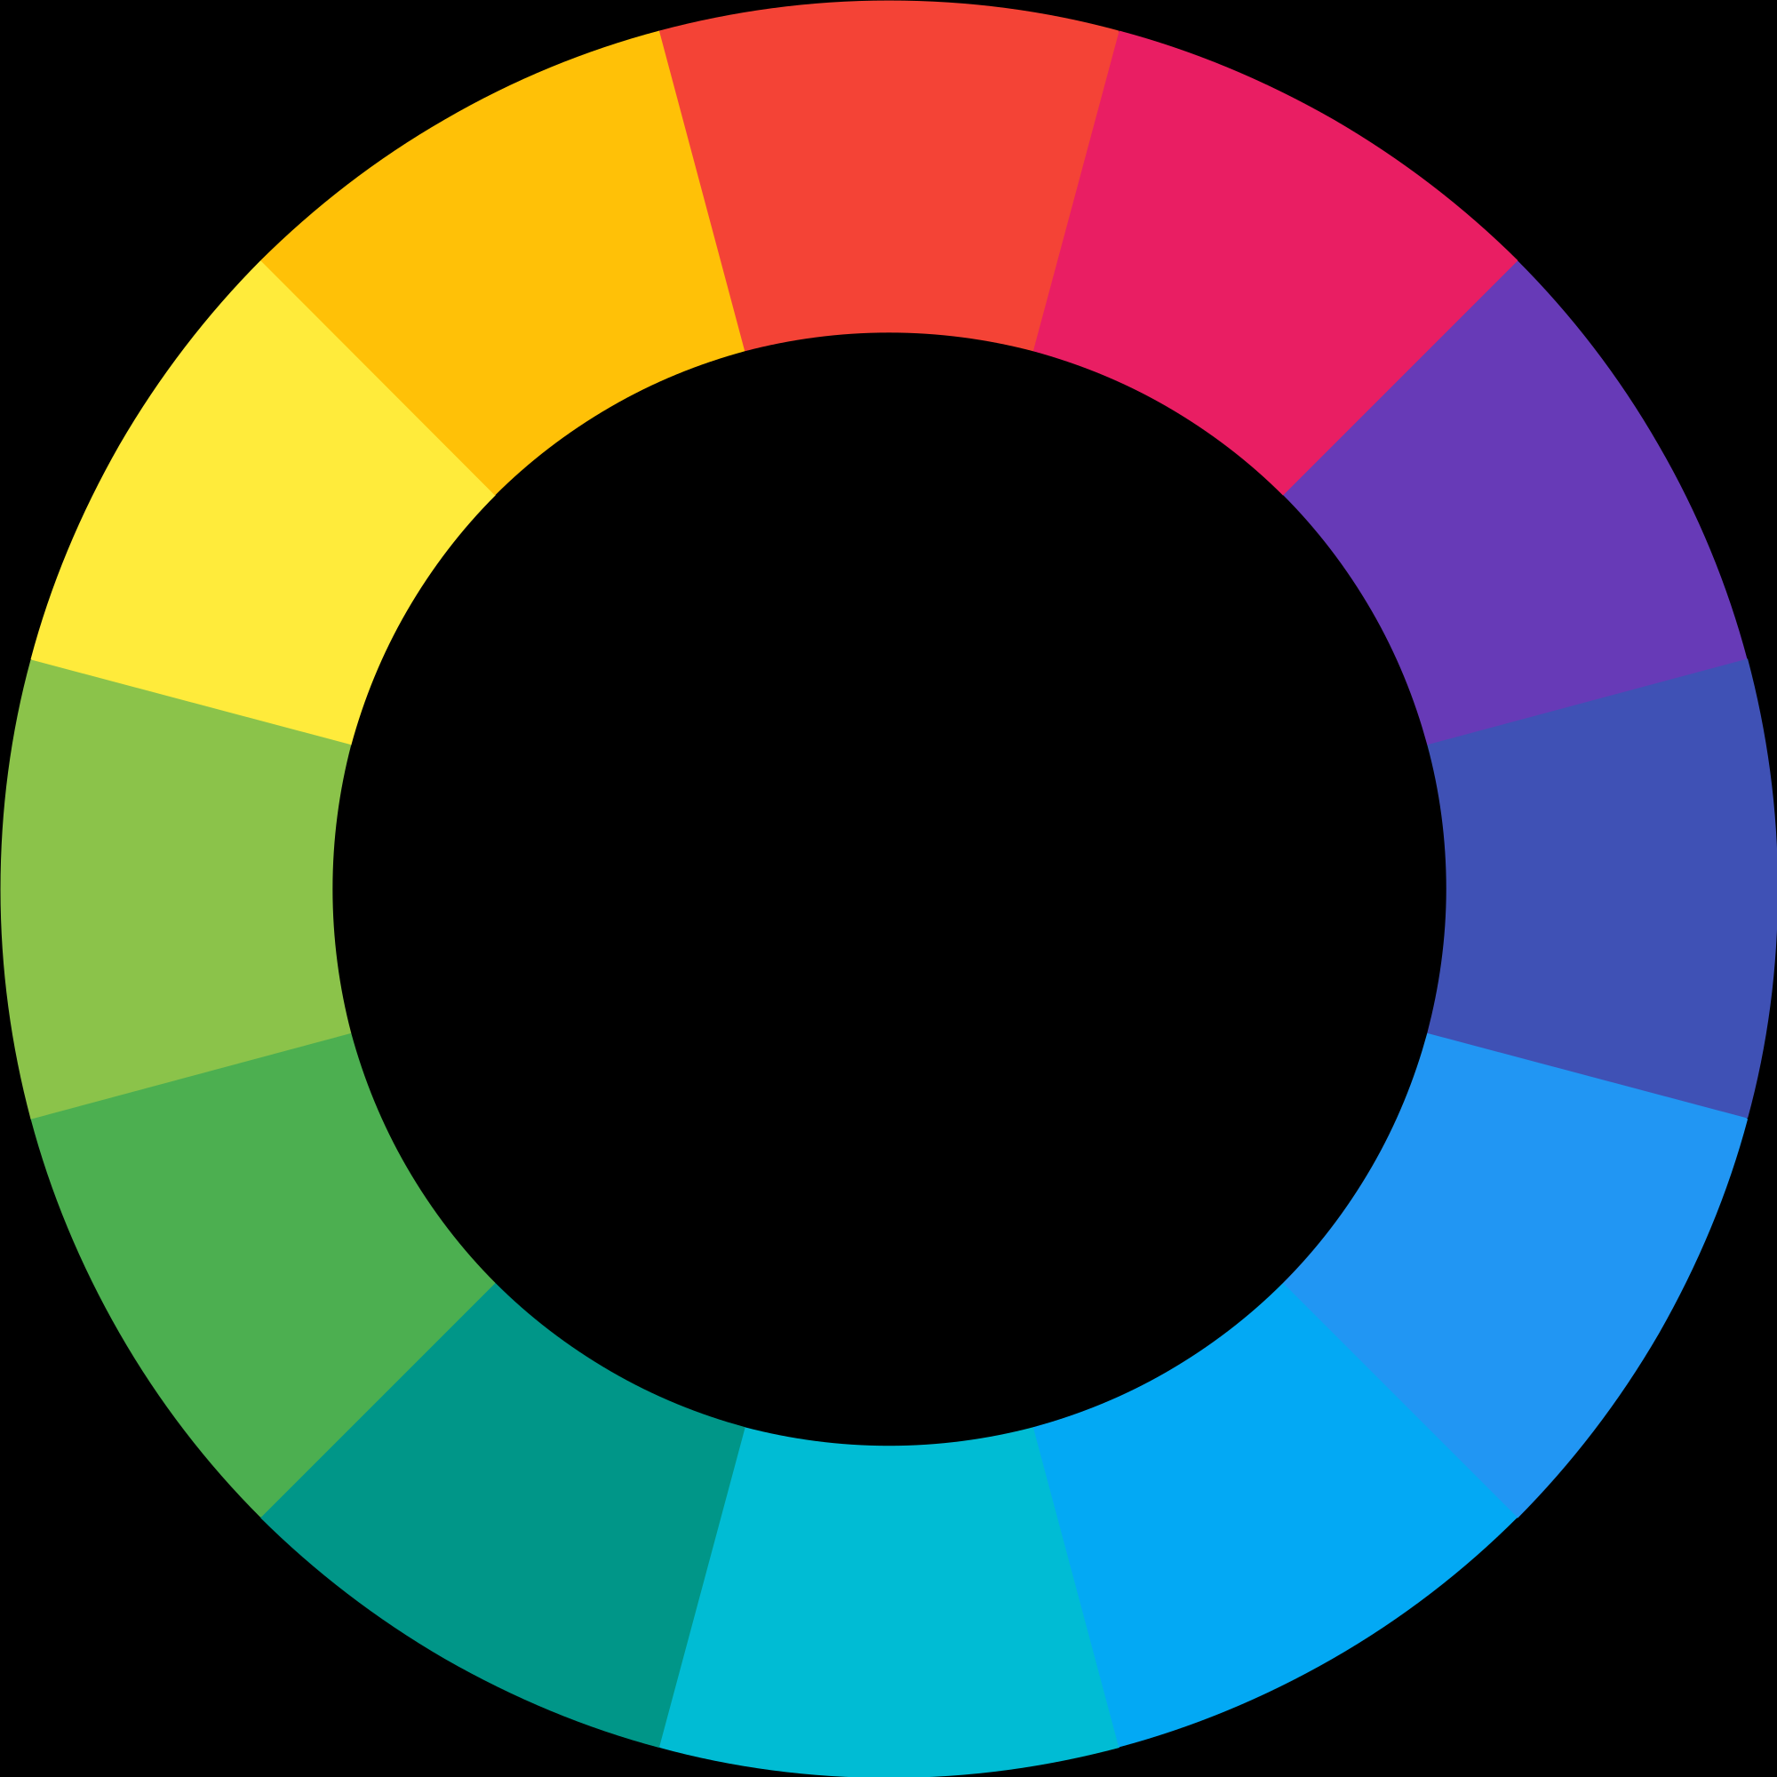
Color and Contrast
Color Wheel

Slide 4
Color and Contrast
Color Wheel
P
T
T
Primary (RGB)
Secondary (CMYK)
S
S
Tertiary
T
T
P
P
T
T
S

Slide 5
Color and Contrast
Complementary

Slide 6
Color and Contrast
Split-Complementary

Slide 7
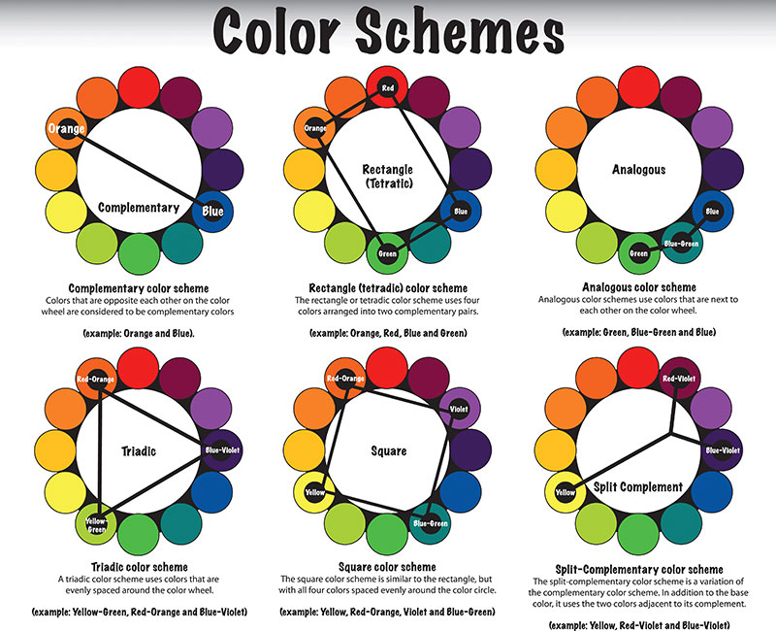
Color and Contrast

Slide 8
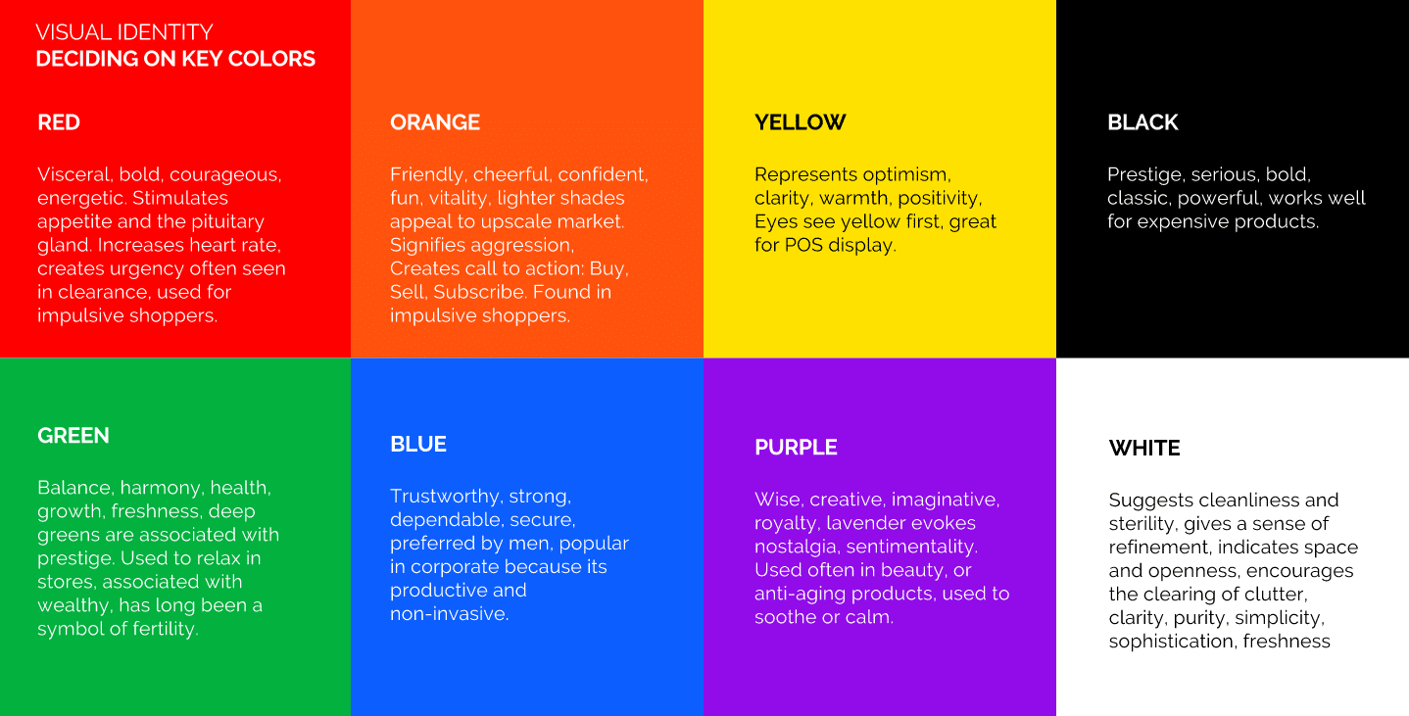

Slide 9
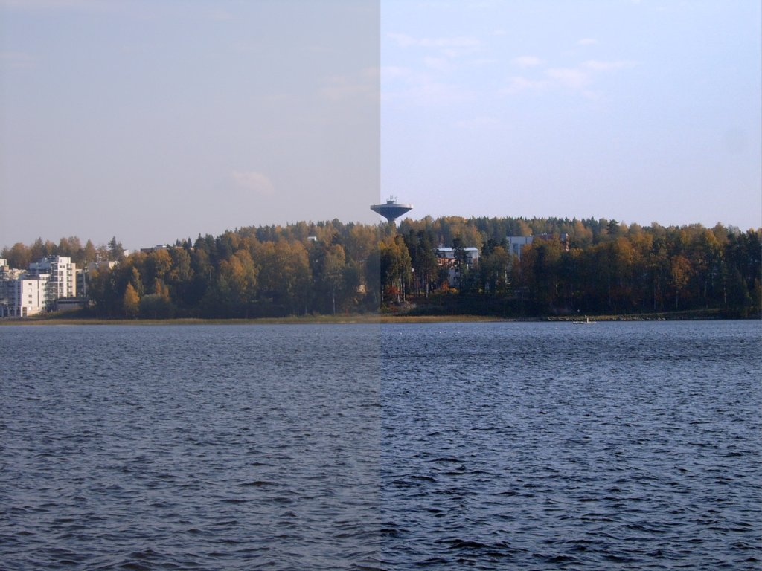
Color and Contrast
Contrast

Slide 10
Call To Action Field
Buy Your Becode T-shirt Now!
Just 5 easy payments of $5.99
Click Me!

Slide 11
Call To Action Field
Buy Your Becode T-shirt Now!
Just 5 easy payments of $20.99
Click Me!

Slide 12
Follow The Rules
Color and Contrast
Typography
Hierarchy
Consistency

Slide 13
Typography
M Serif
Old School
Good for book-reading
Classy feel
M Sans-Serif
Considered Modern
Good for screen-reading
You are mainly going to use this

Slide 14
Typography
Only choose 1 font for your website
→ This will keep loading time fast
→ Difficult to mix fonts
Don’t mess around with spacing
Skip a Weight
Regular
Medium
Bold

Slide 15
Typography
Montserrat
Roboto
Lato
OpenSans
Arial (Microsoft)
Futura
Helvetica (Apple)
Times New Roman

Slide 16
Follow The Rules
Color and Contrast
Typography
Hierarchy
Consistency

Slide 17
Hierarchy
How to show what is important and what is less important?
Font size size size
Font weight weight
Grouping
I am part of grouping

Slide 18
Hierarchy
You will read this first
You will read this second
This confuses you
Do you understand me now?
By the way you read this last

Slide 19
Follow The Rules
Color and Contrast
Typography
Hierarchy
Consistency

Slide 20
Consistency is key!
Use 1 font and use Hierarchy rules
Use a color pallet and stick to is
Coolors.co
Don’t radically change style
vs

Slide 21
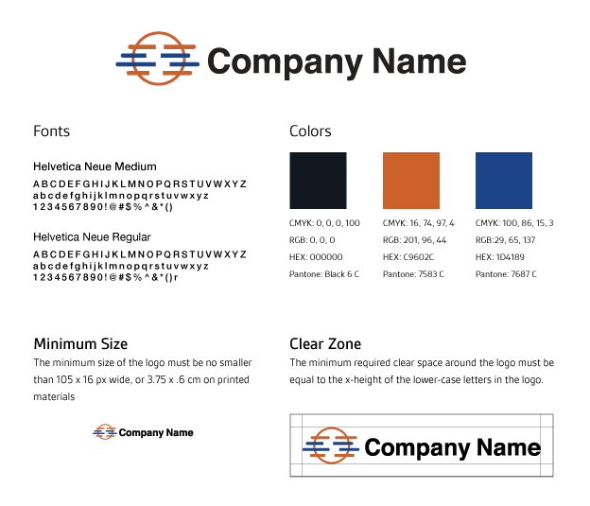
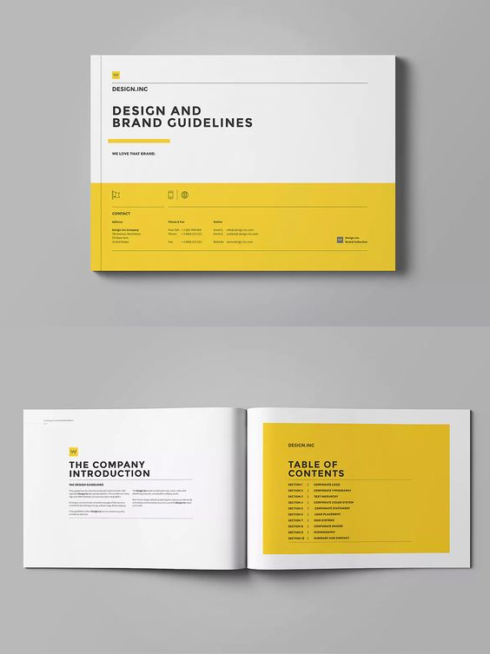

Slide 22
Design Principles
Follow The Rules
Design First Code later

Slide 23
Design First Code Later
Wire frame
Inspiration
Show a friend!

Slide 24
Wire Frame
Blue-Print of your website
Navigation Bar
News Section

Slide 25



Wire Frame
Tools You Can use
Adobe xd
Figma
Sketch (freemium)

Slide 26
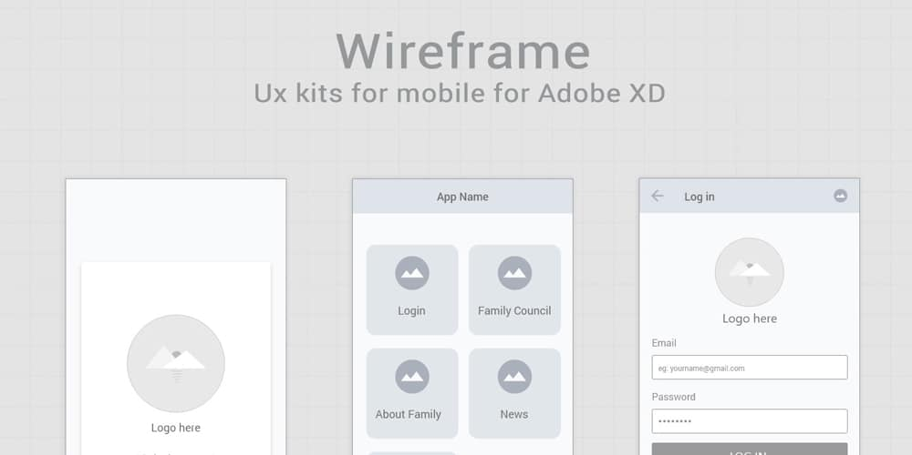
Wire Frame

Slide 27
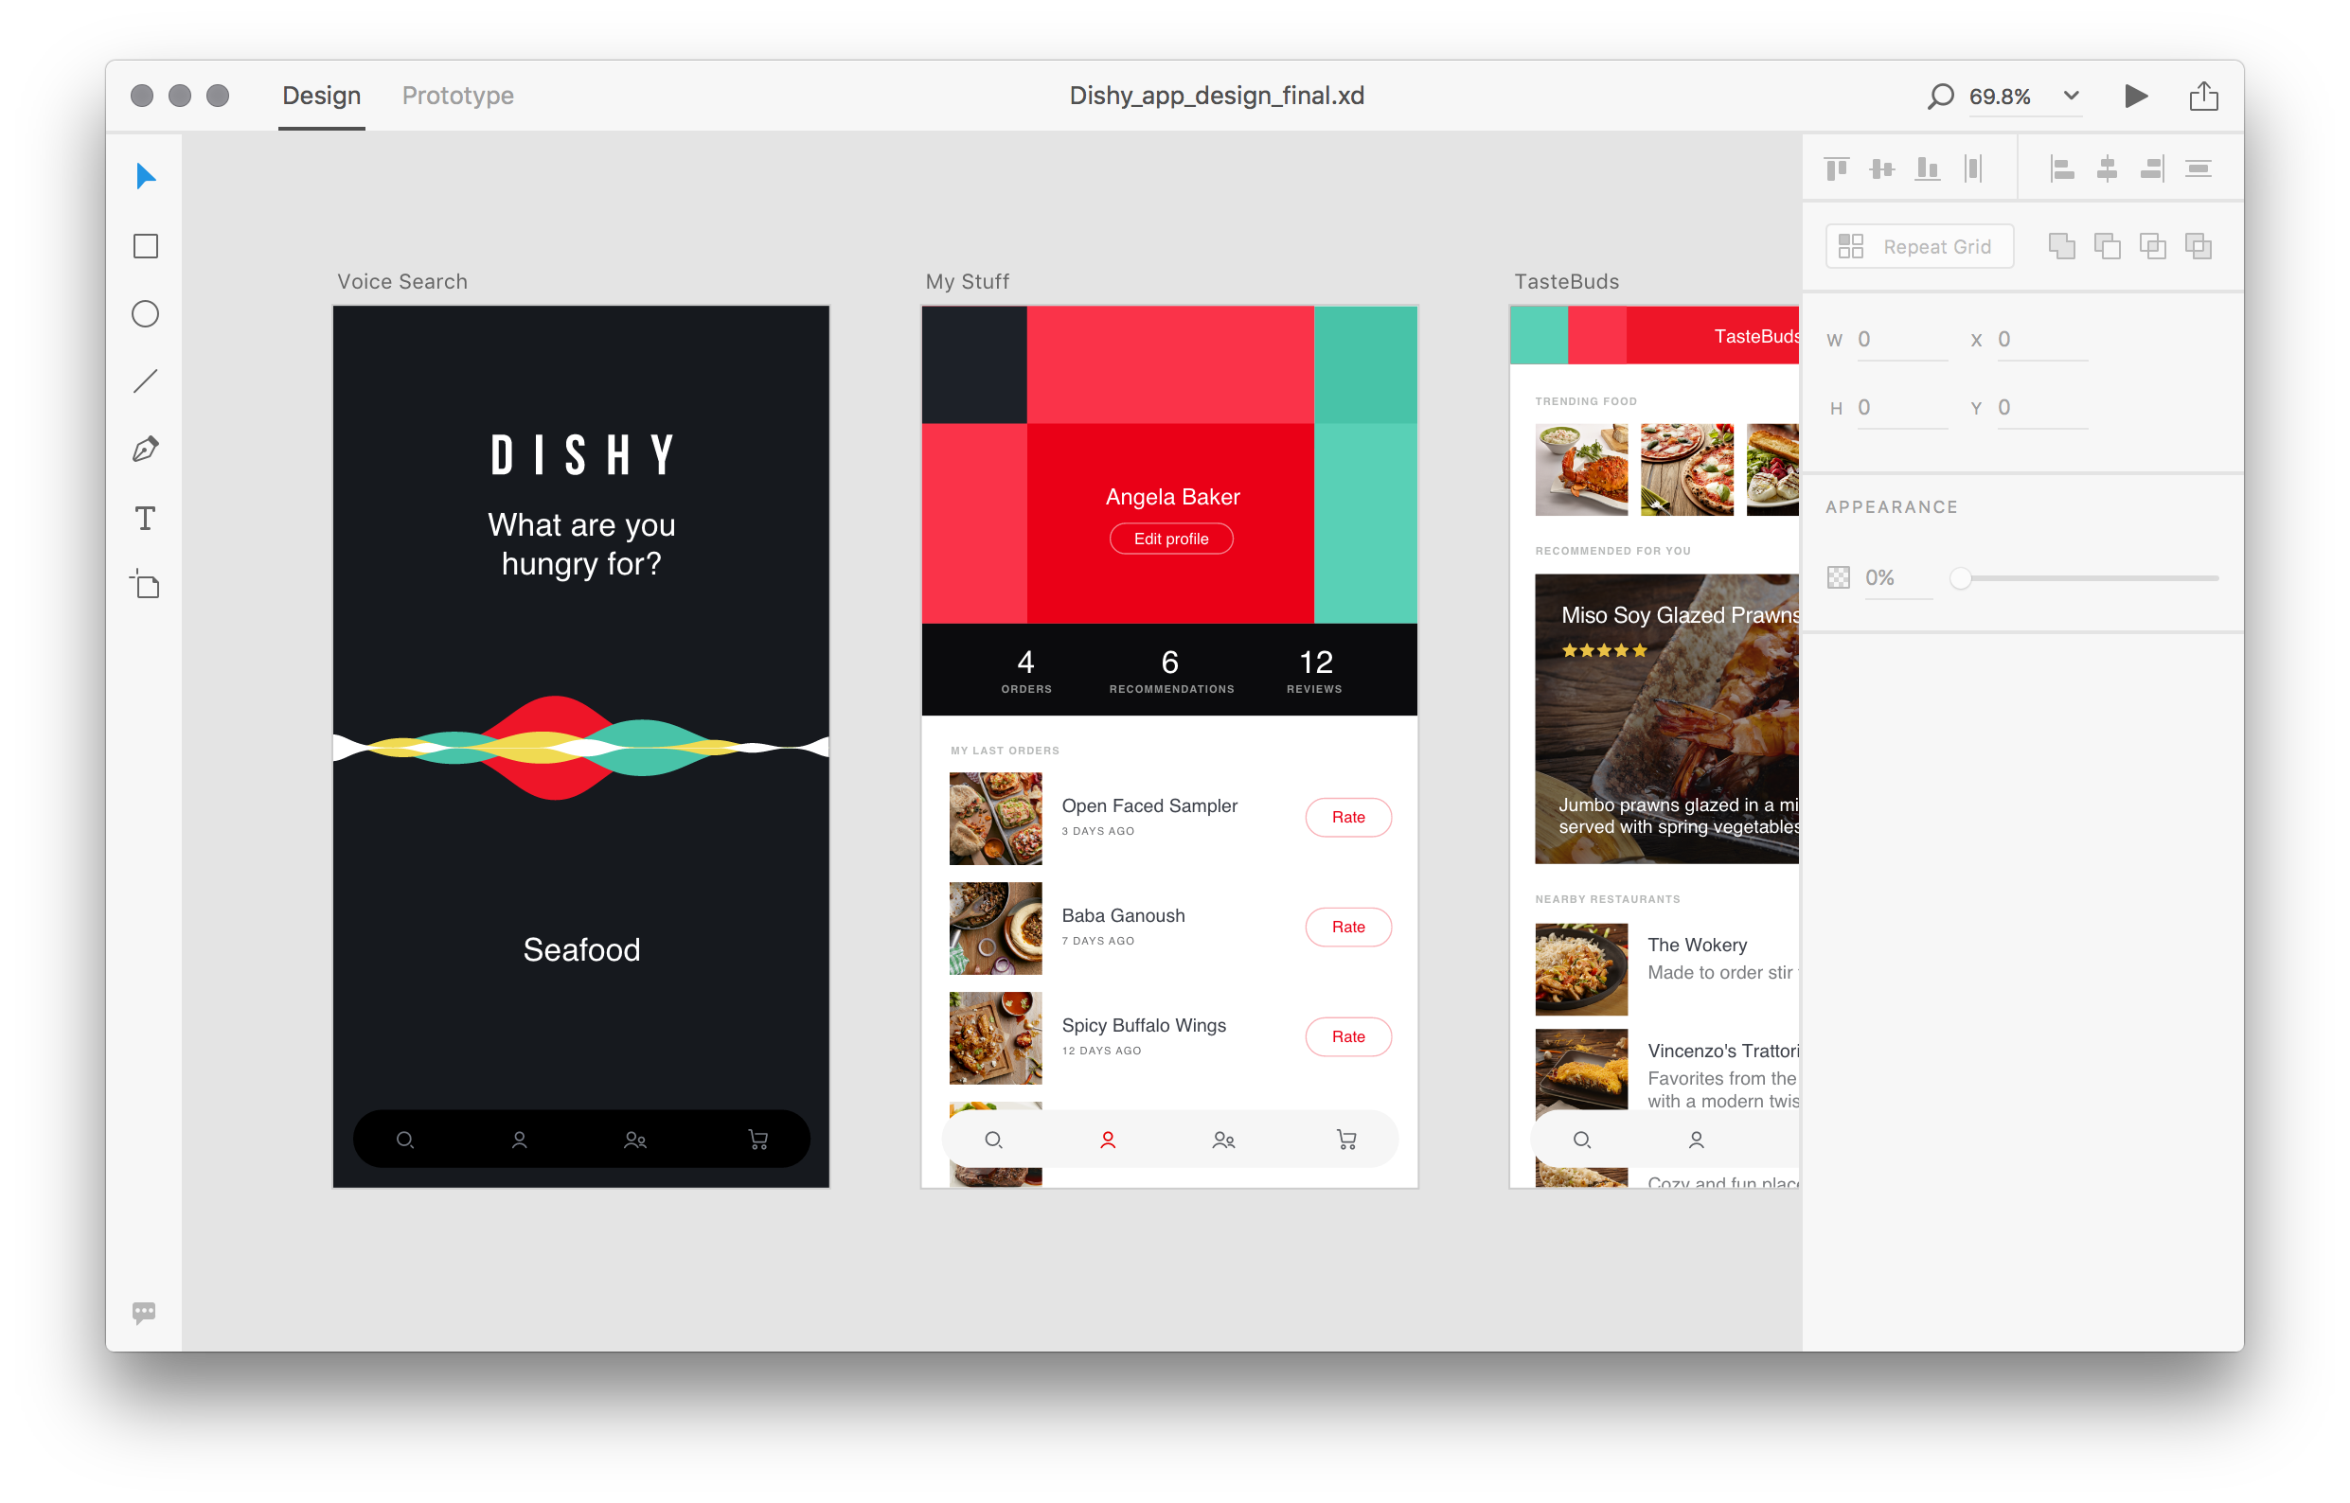
Wire Frame

Slide 28
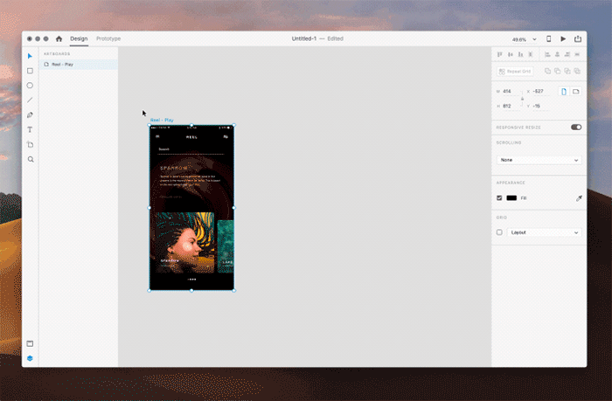
Wire Frame
Wire Frame

Slide 29
Design First Code Later
Wire frame
Inspiration
Show a friend!

Slide 30
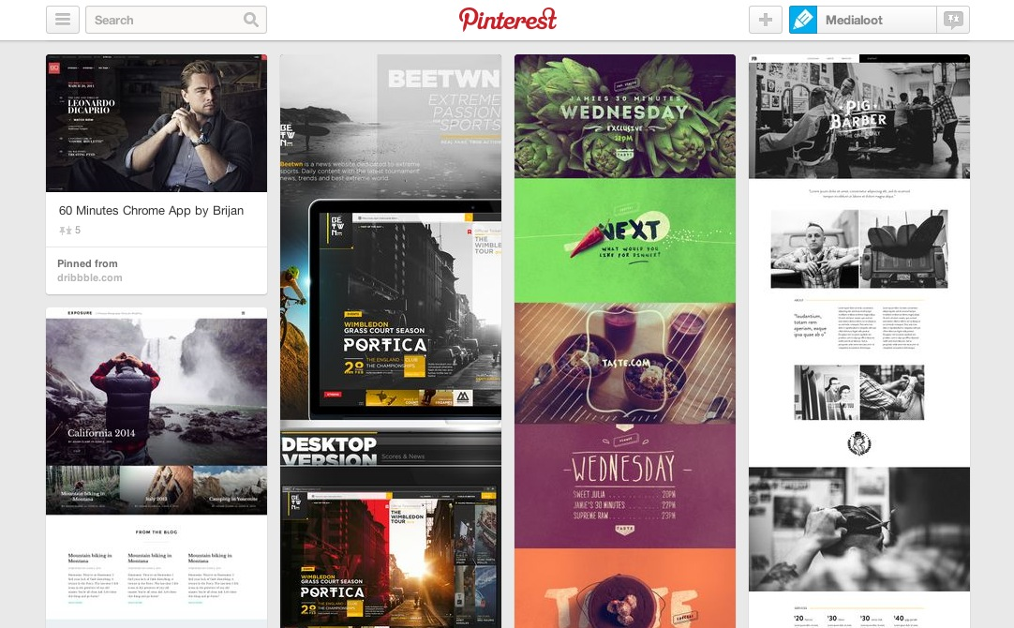
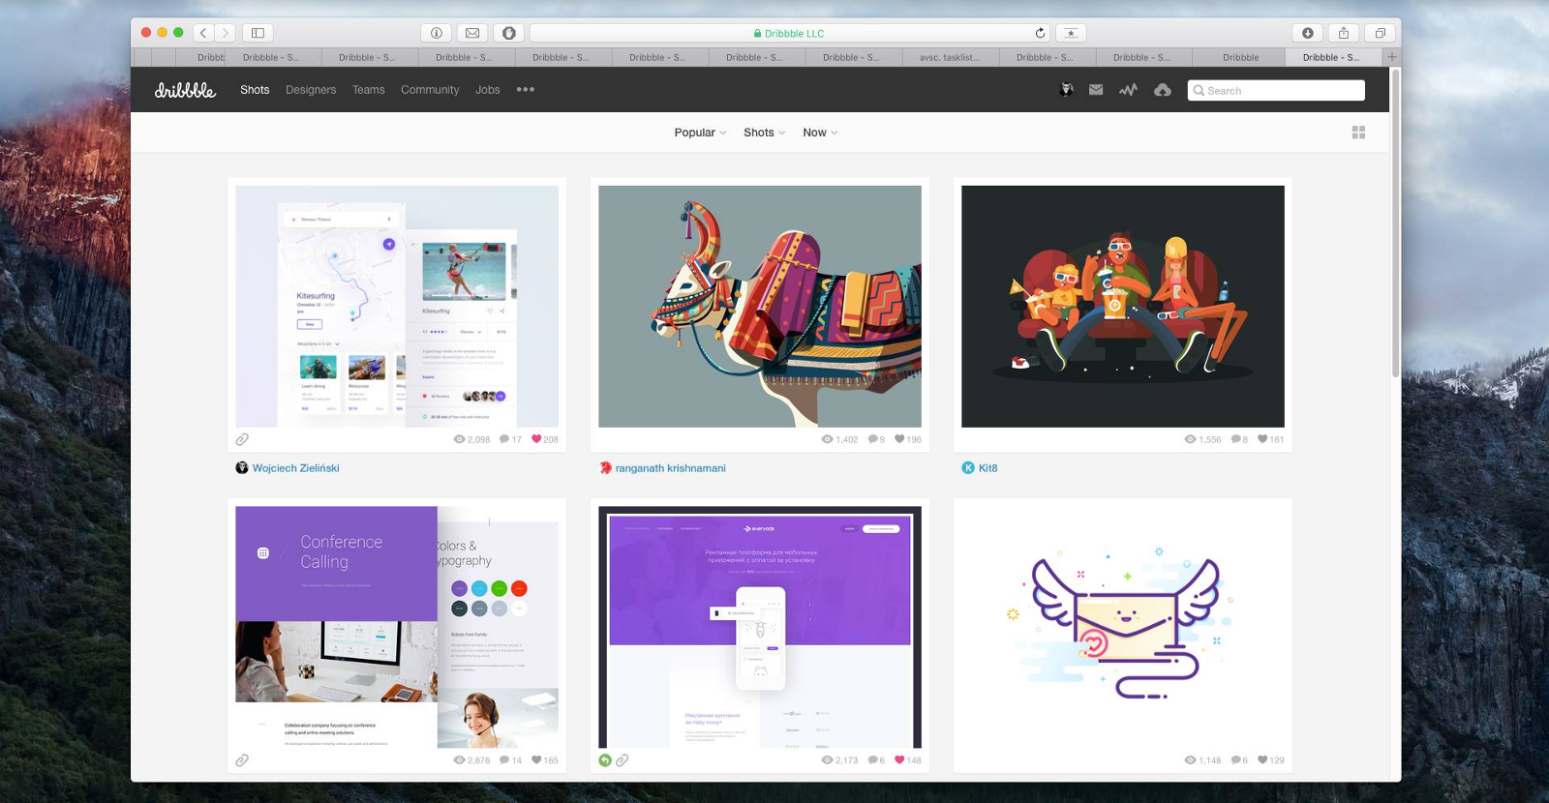
Inspiration
Stuck?
Pinterest
Dribble

Slide 31
Useful Sources
Free Images:
https://unsplash.com/
https://www.pexels.com/
https://burst.shopify.com/
https://www.freepik.com/
Free Icons
https://www.flaticon.com/home
https://www.iconfinder.com/
https://fontawesome.com/icons?d=gallery
Website font
https://fonts.google.com/
https://www.fontsquirrel.com/

Slide 32
Useful Sources
Design Videos:
https://www.youtube.com/watch?v=_Hp_dI0DzY4&t
https://www.youtube.com/watch?v=QrNi9FmdlxY
https://www.youtube.com/watch?v=o9-2sbD1lhU
https://www.youtube.com/watch?v=_2LLXnUdUIc
https://www.youtube.com/watch?v=alswD2tCc_Q
Design site’s:
https://principles.design/
https://www.webdesign.org/

